Slide 1





Title:House Price Prediction Model
Date: 01/03/2024
Course: AI Builder
Mentor Name:
Dr. Abhishek Gagneja Sir
Presented by:
Chehak Sharma
Ankna Litoriya
Anamika Chouragade
Hitakshi Bhopale
Harshita Chouhan
Soumya Joseph

Slide 2
Overview
Introduction
Project Plan
Objectives
Methodology
Review of the Models used
Experimental Results
Conclusion
References

Slide 3
Introduction
In this project, we aim to develop a machine learning model for predicting house prices based on relevant features. We will explore various algorithms, such as linear regression, to determine which one provides the best performance for our dataset . Predicting house prices involves analyzing a myriad of variables, including location, property size, amenities, neighborhood characteristics, economic indicators, and market trends. Traditional methods of valuation, while valuable, often rely on manual appraisal processes and historical data analysis, which may not capture the dynamic nature of real estate markets.

Slide 4
Contribution by team members
1. Chehak Sharma :Development & Designing
2. Ankna Litoriya : Development and documentation
3. Anamika Chouragade :Content and Documentation
4. Harshita Chouhan : Content and Documentation
5. Hitanshi Bhopale :Development & Designing
6. Soumya Joseph : Content and Documentation

Slide 5
Project Plan

Slide 6
Project Schedule
Table 1. Project Schedule
Sl. No. | Phase | Tasks | Start on Day | Duration (Days)
a | Data collection and preprocessing | Data Collection | 1 | 1
b |  | Data labelling, cleaning, augmentation | 2 | 2
c | Initial Model Selection and Training | linear regression | 4 | 2
d |  | Random Forest | 6 | 3
f | Model training and evaluation (5- and 10-fold CV) | Design and implement the novel architecture | 9 | 5
g |  | Hyperparameter tuning | 13 | 5
h | Documentation | Draft report preparation | 18 | 2
i |  | Final report preparation | 20 | 2
j
k |  | Total Duration | 22 days

Slide 7
Objectives
The objective of house prediction using machine learning is
To create robust models that leverage historical data and diverse features to accurately estimate residential property values.
It empowers stakeholders in the real estate ecosystem , such as buyers ,sellers and investors , with data driven insights for making informed decisions .
Machine learning enables enhanced market comprehension, risk mitigation, and better pricing methods by examining several aspects that impact house prices.
This technology supports urban planning , and contributes to transparent real estate market, ultimately benefiting individuals , businesses, and the broader community.

Slide 8
Methodology

Slide 9
Data Collection
We are using California housing price dataset with 20,640 districts.
It includes information on
location (longitude, latitude),
property characteristics (age, rooms, bedrooms),
demographics (population, households, income),
ocean proximity,
target variable: median house value.
This data is often used for training machine learning models to predict house prices.

Slide 10
Data Preprocessing and Augmentation
Data Preprocessing
Handling Missing Values:
Impute with strategies like mean/median of the feature
Remove rows/columns if missing data percentages are high.
Addressing Outliers:
Capping or replacing extreme values to reduce their influence.
Consider using techniques like IQR to identify potential outliers.
Feature Scaling: Normalize or standardize features (e.g., Min-Max scaling, Z-score) for better model convergence, especially with distance-based algorithms.
Encoding Categorical Features: Employ one-hot encoding or label encoding for features like "ocean_proximity".
Data Augmentation
Preprocessing aims to clean and prepare the data for modeling, improving model performance.
Augmentation expands your dataset and can help to prevent overfitting.
Choose techniques that make sense for the specific dataset and task.

Slide 11
Model Training
Prepare Your Data
Split the dataset into features (like location, rooms, income) and the target variable (median house value).
Clean and pre-process: Handle missing values, standardize data if needed.
2. Linear Regression
Import a linear regression model (like scikit-learn's Linear Regression).
It assumes a linear relationship between the features (like square footage) and the target variable (house price).
3.Random Forest Regressor as your model for predicting house prices.
Model Training: This trains the model on the training data (x_train and y_train). During training, the model learns the relationship between the features and the house prices.

Slide 12
Model Training (Contd.)
4. Train the Model
Fit the model to your training data. This means it learns the relationship between your features and the house prices.
5. Make Predictions
Use the trained model to predict house prices on new, unseen data (e.g., put in a new location, number of rooms, etc.).
6. Evaluate Performance
Use metrics like Mean Squared Error (MSE) or R-squared to see how well your model performs on unseen test data.

Slide 13
Model Evaluation
Model Performance Evaluation
Accuracy
Confusion Matrix
Visualisation
Grid Search Cross Validation (GS CV), a technique commonly used for model evaluation and hyperparameter tuning.
Defines Hyperparameter Grid
Cross-Validation: Splits your data into multiple folds (e.g., 5 folds)
Scoring: Uses a metric (e.g., negative Mean Squared Error) to determine how well each combination performs.
Best Selection: Picks the hyperparameter combination that yields the best average score across folds.

Slide 14
Review of the Models used

Slide 15
Linear Regression
Simple Model:
Linear Regression is a straightforward and interpretable algorithm, assuming a linear relationship between features and the target variable.
Minimization of Residuals:
The model minimizes the sum of squared differences (residuals) between predicted and actual values to find the best-fit line.
Coefficients Interpretation:
Coefficients in the linear equation represent the impact of each feature on the target variable, aiding interpretability.
Assumptions:
Assumes a linear relationship, independence of features, homoscedasticity (constant variance of residuals), and normal distribution of residuals.
Baseline Comparison:
Often used as a baseline model for comparison with more complex algorithms due to its simplicity.

Slide 16
Random Forest
Ensemble Learning:
Random Forest Regressor is an ensemble method that constructs multiple decision trees to improve overall predictive accuracy.
Decision Tree Composition:
Builds a multitude of decision trees during training and combines their predictions to reduce overfitting and enhance generalization.
Feature Randomization:
Introduces randomness by using a random subset of features for each decision tree, promoting diverse tree constructions.
Hyperparameter Tuning:
Fine-tunes performance through hyperparameter optimization, adjusting parameters like the number of trees and maximum depth.
High Predictive Power:
Known for its ability to capture complex relationships in data, making it suitable for accurate predictions in various machine learning tasks.

Slide 17
Grid Search with Cross-Validation
Parameter Optimization:
Grid Search with Cross-Validation systematically explores a predefined parameter grid to find the optimal combination for a machine learning algorithm.
Hyperparameter Space:
Specifies a range of hyperparameter values to be tested, allowing for a comprehensive search over potential configurations.
Cross-Validation:
Incorporates cross-validation to assess model performance, splitting the dataset into multiple subsets for training and testing to ensure robustness.
Scoring Metric:
Utilizes a predefined scoring metric (e.g., mean squared error) to evaluate and compare model performance for each parameter combination.
Best Model Selection:
Identifies the hyperparameter combination that yields the best performance based on the specified scoring metric, optimizing the model for accurate predictions.

Slide 18
Logarithmic Transformations:
Skewness Correction:
Logarithmic transformations are applied to variables with skewed distributions, helping to normalize and balance data.
One-Sided Values:
Particularly effective for features with one-sided, right-skewed distributions, such as total rooms, total bedrooms, population, and households.
Reduced Sensitivity:
Mitigates the impact of extreme values, reducing sensitivity to outliers and enhancing the stability of statistical analyses.
Interpretability Improvement:
Improves interpretability by compressing large ranges of values, making relationships between variables more linear and easier to understand.
Statistical Assumptions:
Alleviates violations of statistical assumptions, such as normality, promoting more accurate modeling and analysis.

Slide 19
Experimental Results

Slide 20
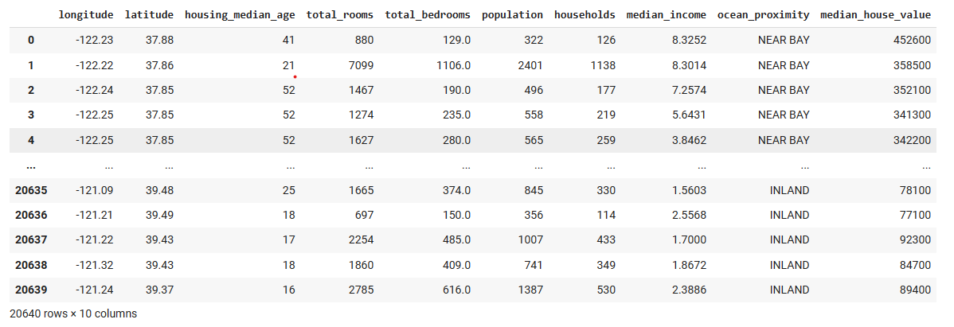
Model Description

Slide 21
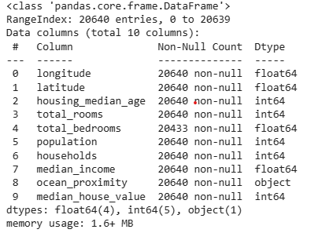
Model Description (Contd.)

Slide 22
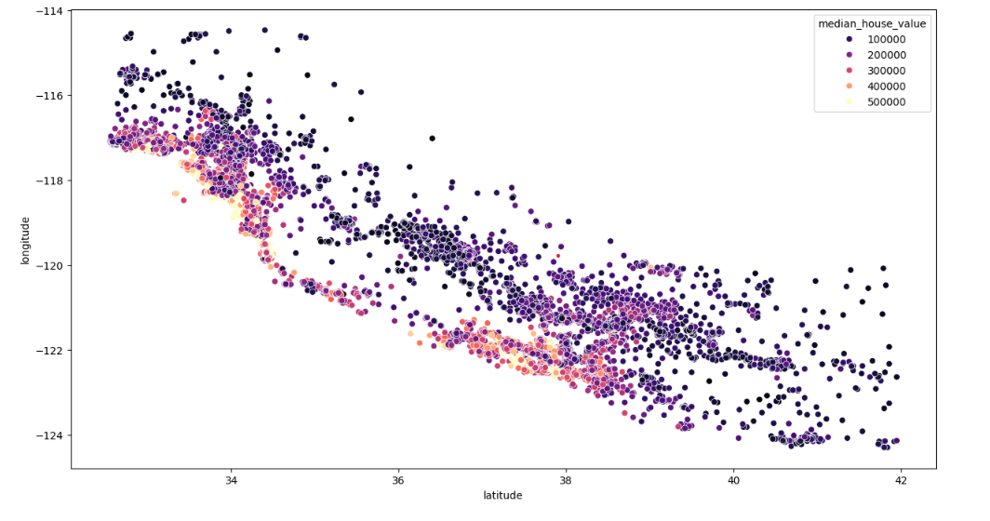
Scatter Plot

Slide 23
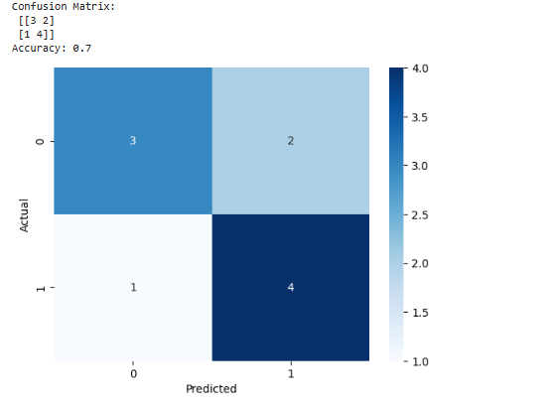
Grid search cross validation

Slide 24
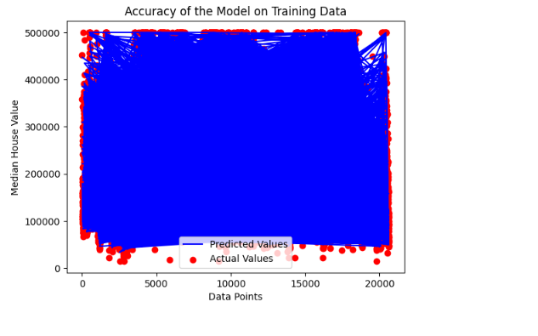
ROC curves, Learning Curves
Dec, 2023
29

Slide 25
Conclusion
In conclusion, our project on house price prediction has demonstrated the effectiveness of machine learning algorithms in forecasting real estate prices. Through the analysis of various features such as location, property size, amenities, and economic indicators, we have developed a model capable of making accurate predictions.
Future Enhancements:
While our model has shown promising results, there are several avenues for future enhancement and research:
1. Feature engineering
2. User Interface Development

